Slide 1

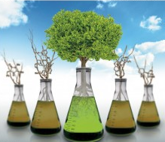
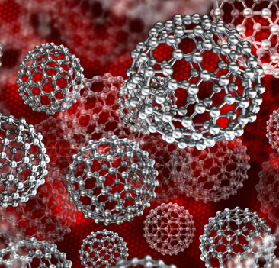
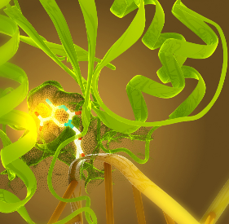
RESEARCH THEMEs at Chem Chula
Green & Sustainable
Chemistry
Materials Chemistry
Chemical Biology &
Medicinal Chemistry
For more information
Catalysis
New chemical process
Greener & safer materials
Environmental monitoring
Environmental remediation
Optical materials
Electrical materials
Magnetic materials
Polymer chemistry
Device fabrication
Molecular design
Natural products
Cellular studies
Drug delivery
Food and agrochemistry
http://web.chemcu.org

Slide 2


OUR GRADUATE PROGRAMS (MSc and Ph.D.)
Program 1: Chemistry
Program 2: Green Chemistry and Sustainability
The course focuses on cutting-edge research in all areas of modern chemistry, including analytical, inorganic, organic and physical chemistry.
Solving many of the global challenges today requires both a strong understanding of the principles of chemistry as well as practice entrepreneurial skills. Our program combines scientific excellence with innovation management and entrepreneurship.

Slide 3





CONTACT
http://web.chemcu.org
Ms. Thitirat Phankham
Thitirat.ph@chula.ac.th
http://greensi.chemcu.org
Mr. Suwat Mueangta
suwat.m@chula.ac.th
ChemCUGraduateStudy
http://www.facebook.com/ChemCuGraduateStudy

