Slide 1


Department of Chemistry
Faculty of Science

Slide 2
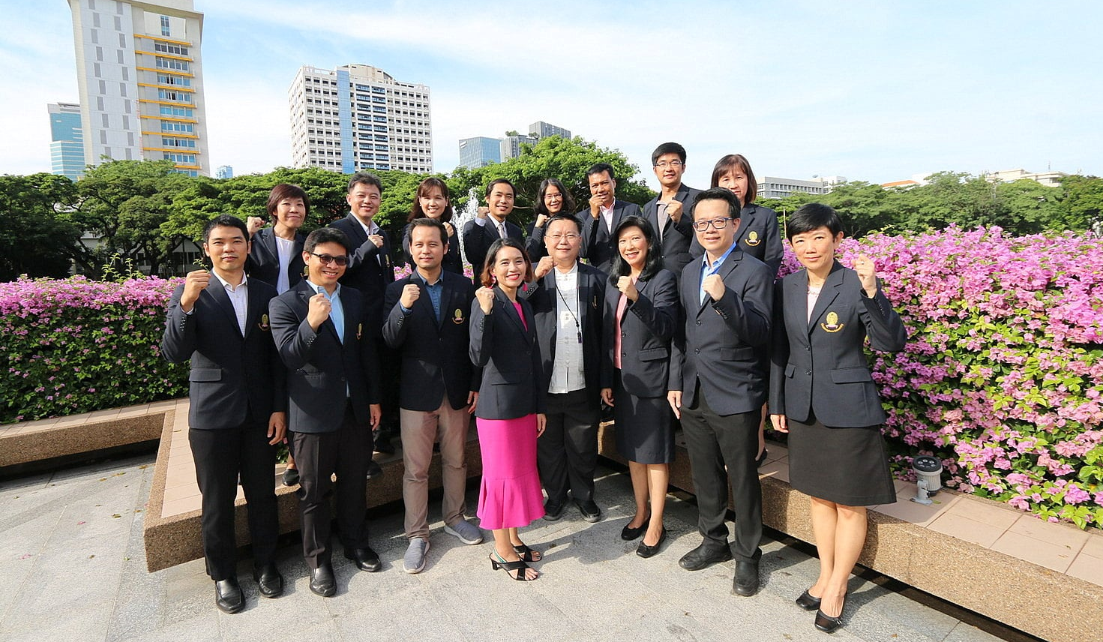
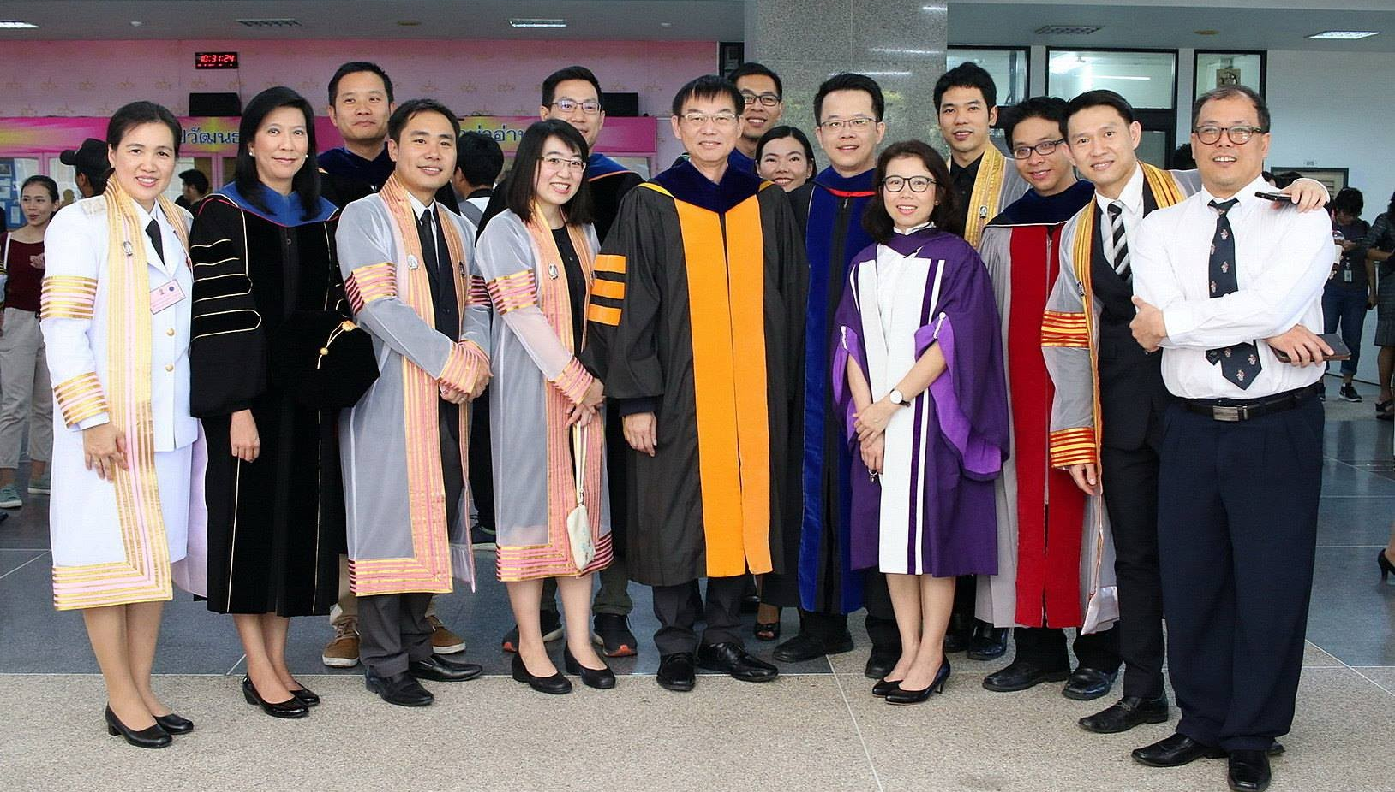
FACTS AND FIGURES
154
142 MB
Top 200
214
69
Research grant 2019-2022
Graduate students
(42% international)
Academic staffs
(22Professors)
Articles published in 2022, 27% in tier-1 journals
Chemistry Subject by QS World University Ranking

Slide 3
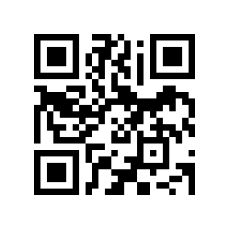
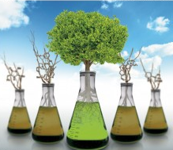
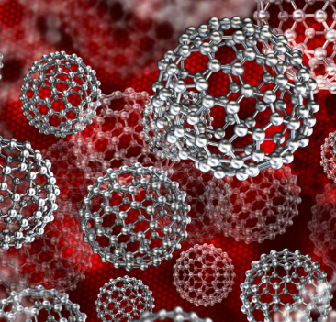
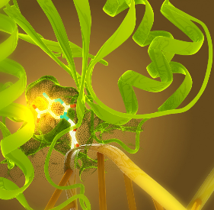
RESEARCH THEME
Green & Sustainable
Chemistry
Materials Chemistry
Chemical Biology &
Medicinal Chemistry
For more information
Catalysis
New chemical process
Greener & safer materials
Environmental monitoring
Environmental remediation
Optical materials
Electrical materials
Magnetic materials
Polymer chemistry
Device fabrication
Molecular design
Natural products
Cellular studies
Drug delivery
Food and agrochemistry
http://web.chemcu.org

Slide 4
RESEARCH THEME
Green & Sustainable
Chemistry
Materials Chemistry
Chemical Biology &
Medicinal Chemistry
For more information
Catalysis
New chemical process
Greener & safer materials
Environmental monitoring
Environmental remediation
Optical materials
Electrical materials
Magnetic materials
Polymer chemistry
Device fabrication
Molecular design
Natural products
Cellular studies
Drug delivery
Food and agrochemistry
http://web.chemcu.org

Slide 5














CORPORATE PARTNERSHIP

Slide 6
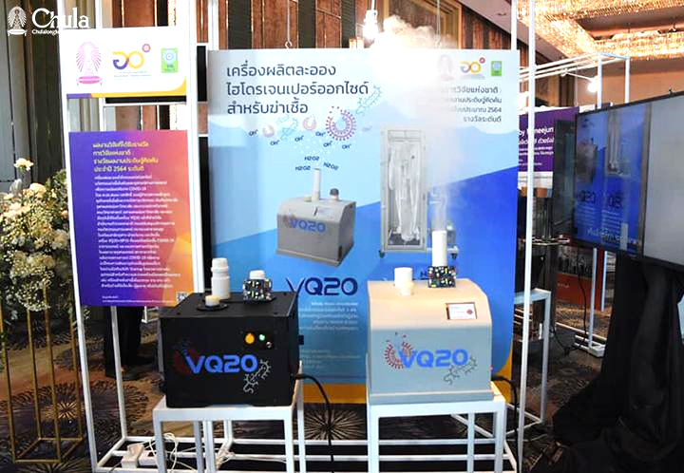
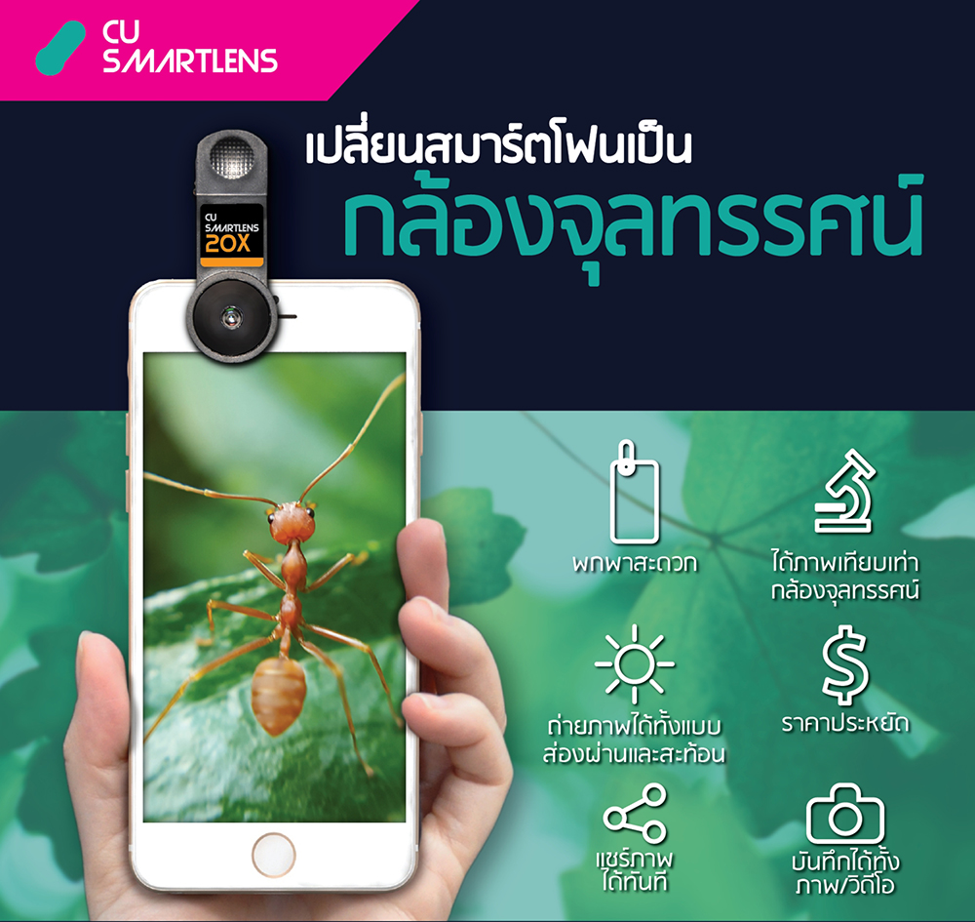
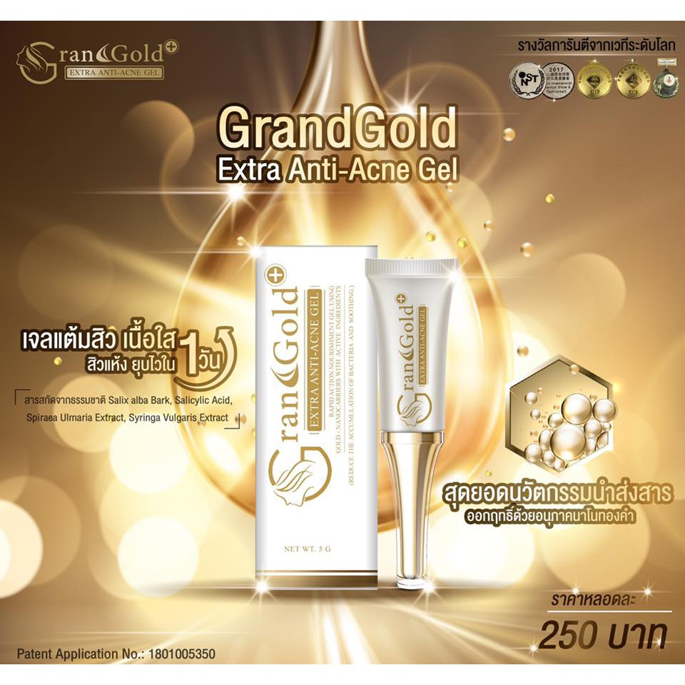
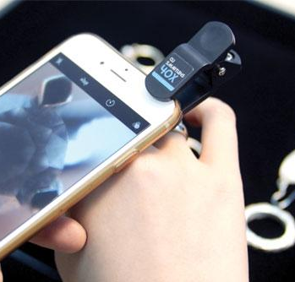

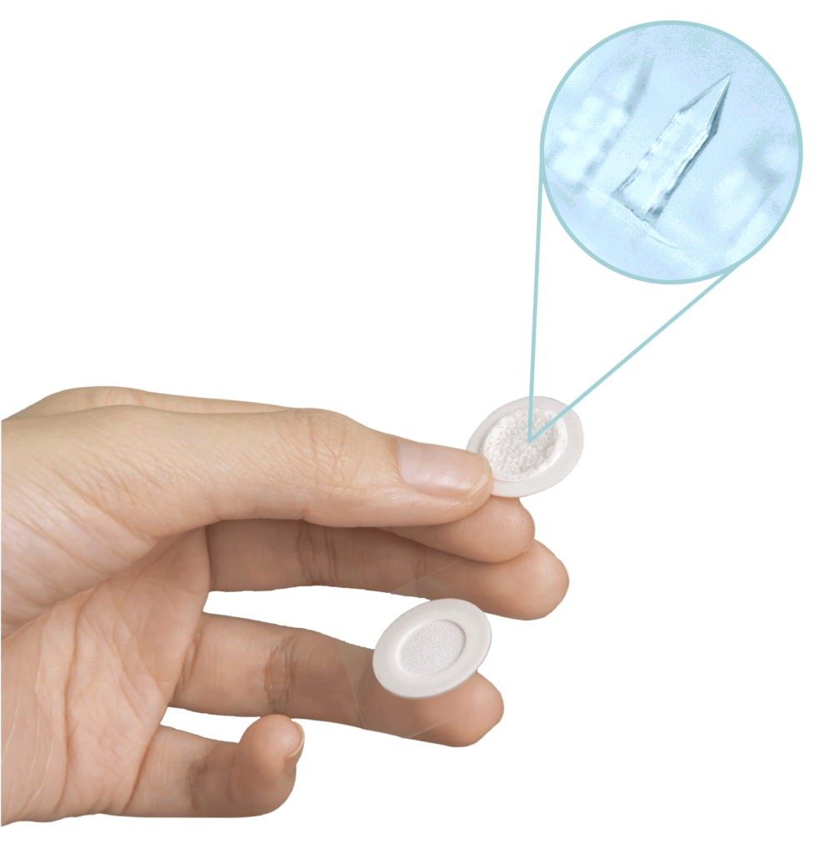




FROM RESEARCH TO COMMERCIALIZATION

Slide 7



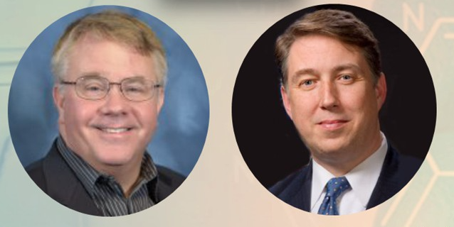
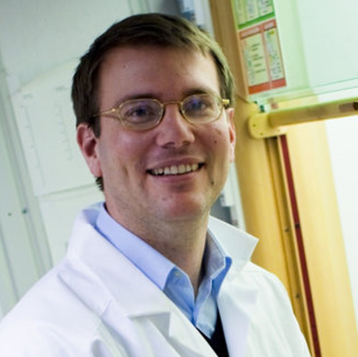
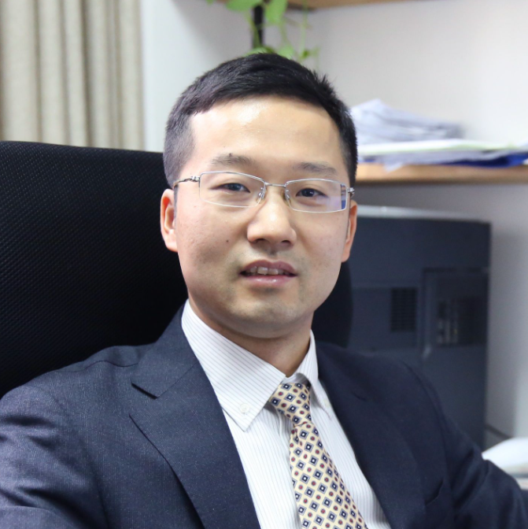
Industrial placement
INTERNATIONAL EXPERTS
Distinguished Professors Professor John C. Warner
(Zymergen Corporation, Monash University)
Professor Paul T. Anastas
(Yale University)
Adjunct Professors Professor Joseph Samec
(Stockholm University)
Professor Xiaoguang Lei
(Peking University)

Slide 8


OUR GRADUATE PROGRAMS (MSc and Ph.D.)
Program 1: Chemistry
Program 2: Green Chemistry and Sustainability
The course focuses on cutting-edge research in all areas of modern chemistry, including analytical, inorganic, organic and physical chemistry.
Solving many of the global challenges today requires both a strong understanding of the principles of chemistry as well as practice entrepreneurial skills. Our program combines scientific excellence with innovation management and entrepreneurship.

Slide 9



PROGRAM 1: CHEMISTRY
Duration M.Sc. 2-3 years, Ph.D. 3-6 years (from MSc. graduates) or 4-8 years (from BSc. graduates)
Requirement 1 international publication
Physical Chemistry
Organic Chemistry
Inorganic Chemistry
Analytical Chemistry
Option: Dual Degrees
Mathematical methods and thermodynamics
Quantum chemistry and spectroscopy
Solution chemistry and surface and colloids
Advanced organic chemistry
Advanced organic synthesis
Spectroscopy of
organic compounds
Organic reactions and mechanisms
Advanced inorganic chemistry
Characterization
of inorganic compounds
Organotransition
metal chemistry
Separation techniques
Electroanalytical chemistry
Spectroanalytical chemistry

Slide 10

PROGRAM 2: GREEN CHEMISTRY AND SUSTAINABILITY
Highlight Co-designed with Dr. John C. Warner, the father of green chemistry
Duration MSc 2-3 years Ph.D. 3-6 years
Requirement 1 international publication
Green and Sustainable Chemistry
Skills & Chemical entrepreneurship
Foundation
Process
Instrument
Green and Sustainable Chemistry
Chemical toxicology and risk management
Advancement in green technology
Industrial chemistry
Industrial placement
Innovation management
Business concepts
Introduction to Nanochemistry
Advanced Material Chemistry
Principles of Chemical Biology
Separation Techniques
Advanced Organic Synthesis
Water Analysis and Decontamination Technology
Advanced Material Characterization
Electroanalytical chemistry
Spectroanalytical chemistry
“Personalize course by choosing modules of study from different subjects to match your research interest”

Slide 11



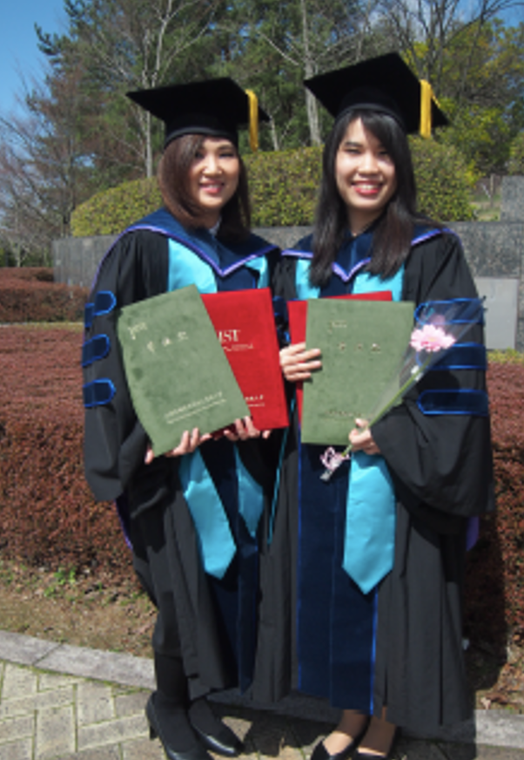
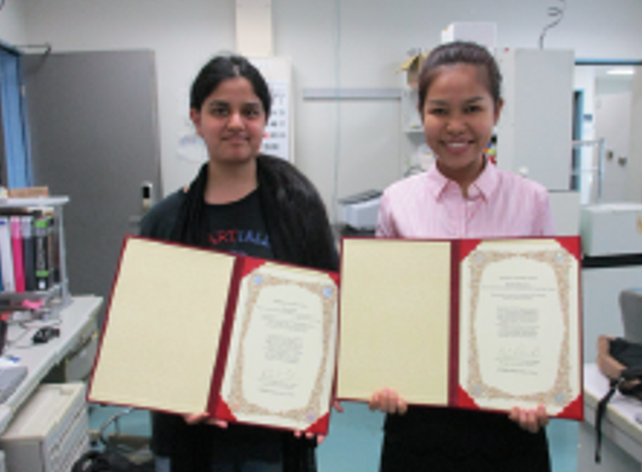

DUAL DEGREE AND RESEARCH EXCHANGE PROGRAM
Research
Exchange
Dual Degree
CU-KU International
Exchange Program
“Lab Research Internship”
CU- JAIST
Japan Advanced Institute of Science and Technology (JAIST)
Chemical Science Course
Internship program
Institute for Molecular Science Internship Program in ASIA
“IMS-IIPA”

Slide 12
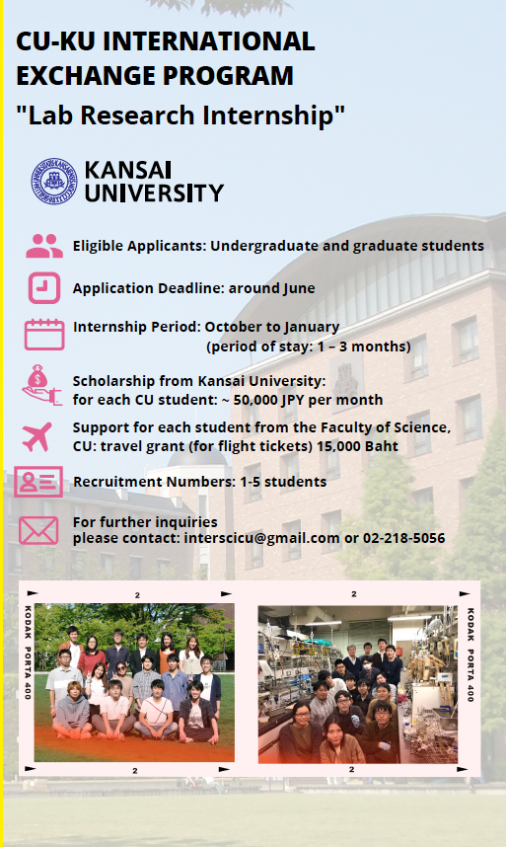
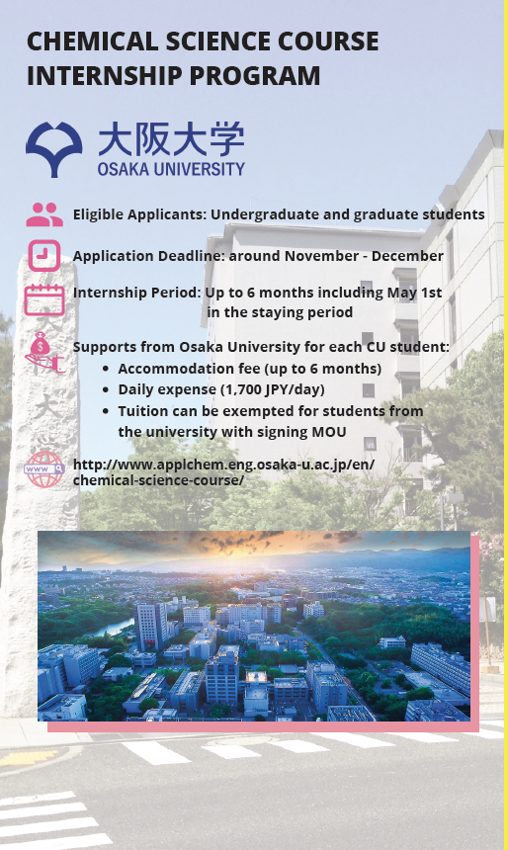
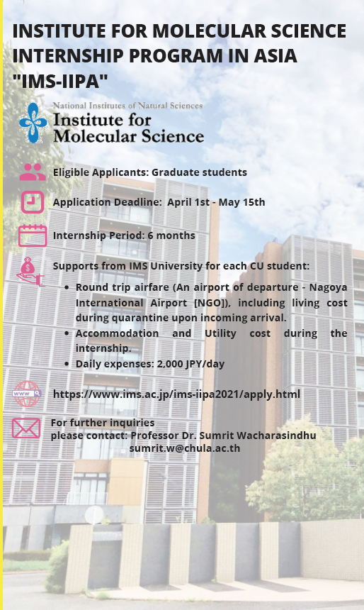
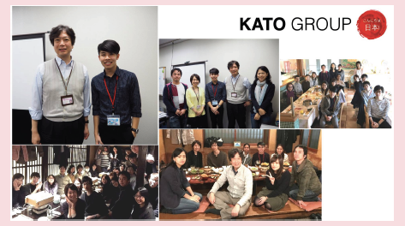
RESEARCH EXCHANGE PROGRAM

Slide 13
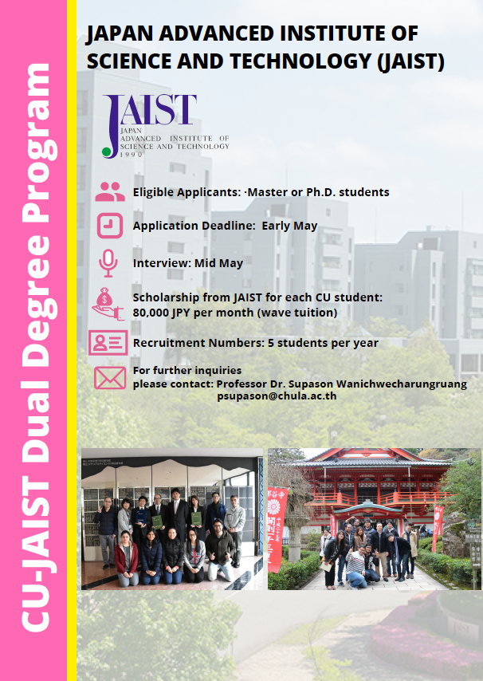
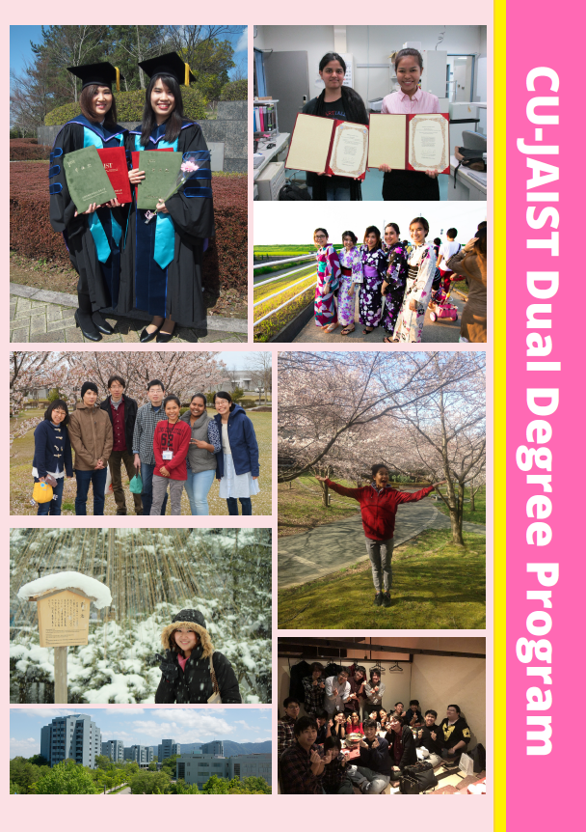
DUAL DEGREE : CU-JAIST
Notes:
CU-JAIST Dual Degree Program

Slide 14
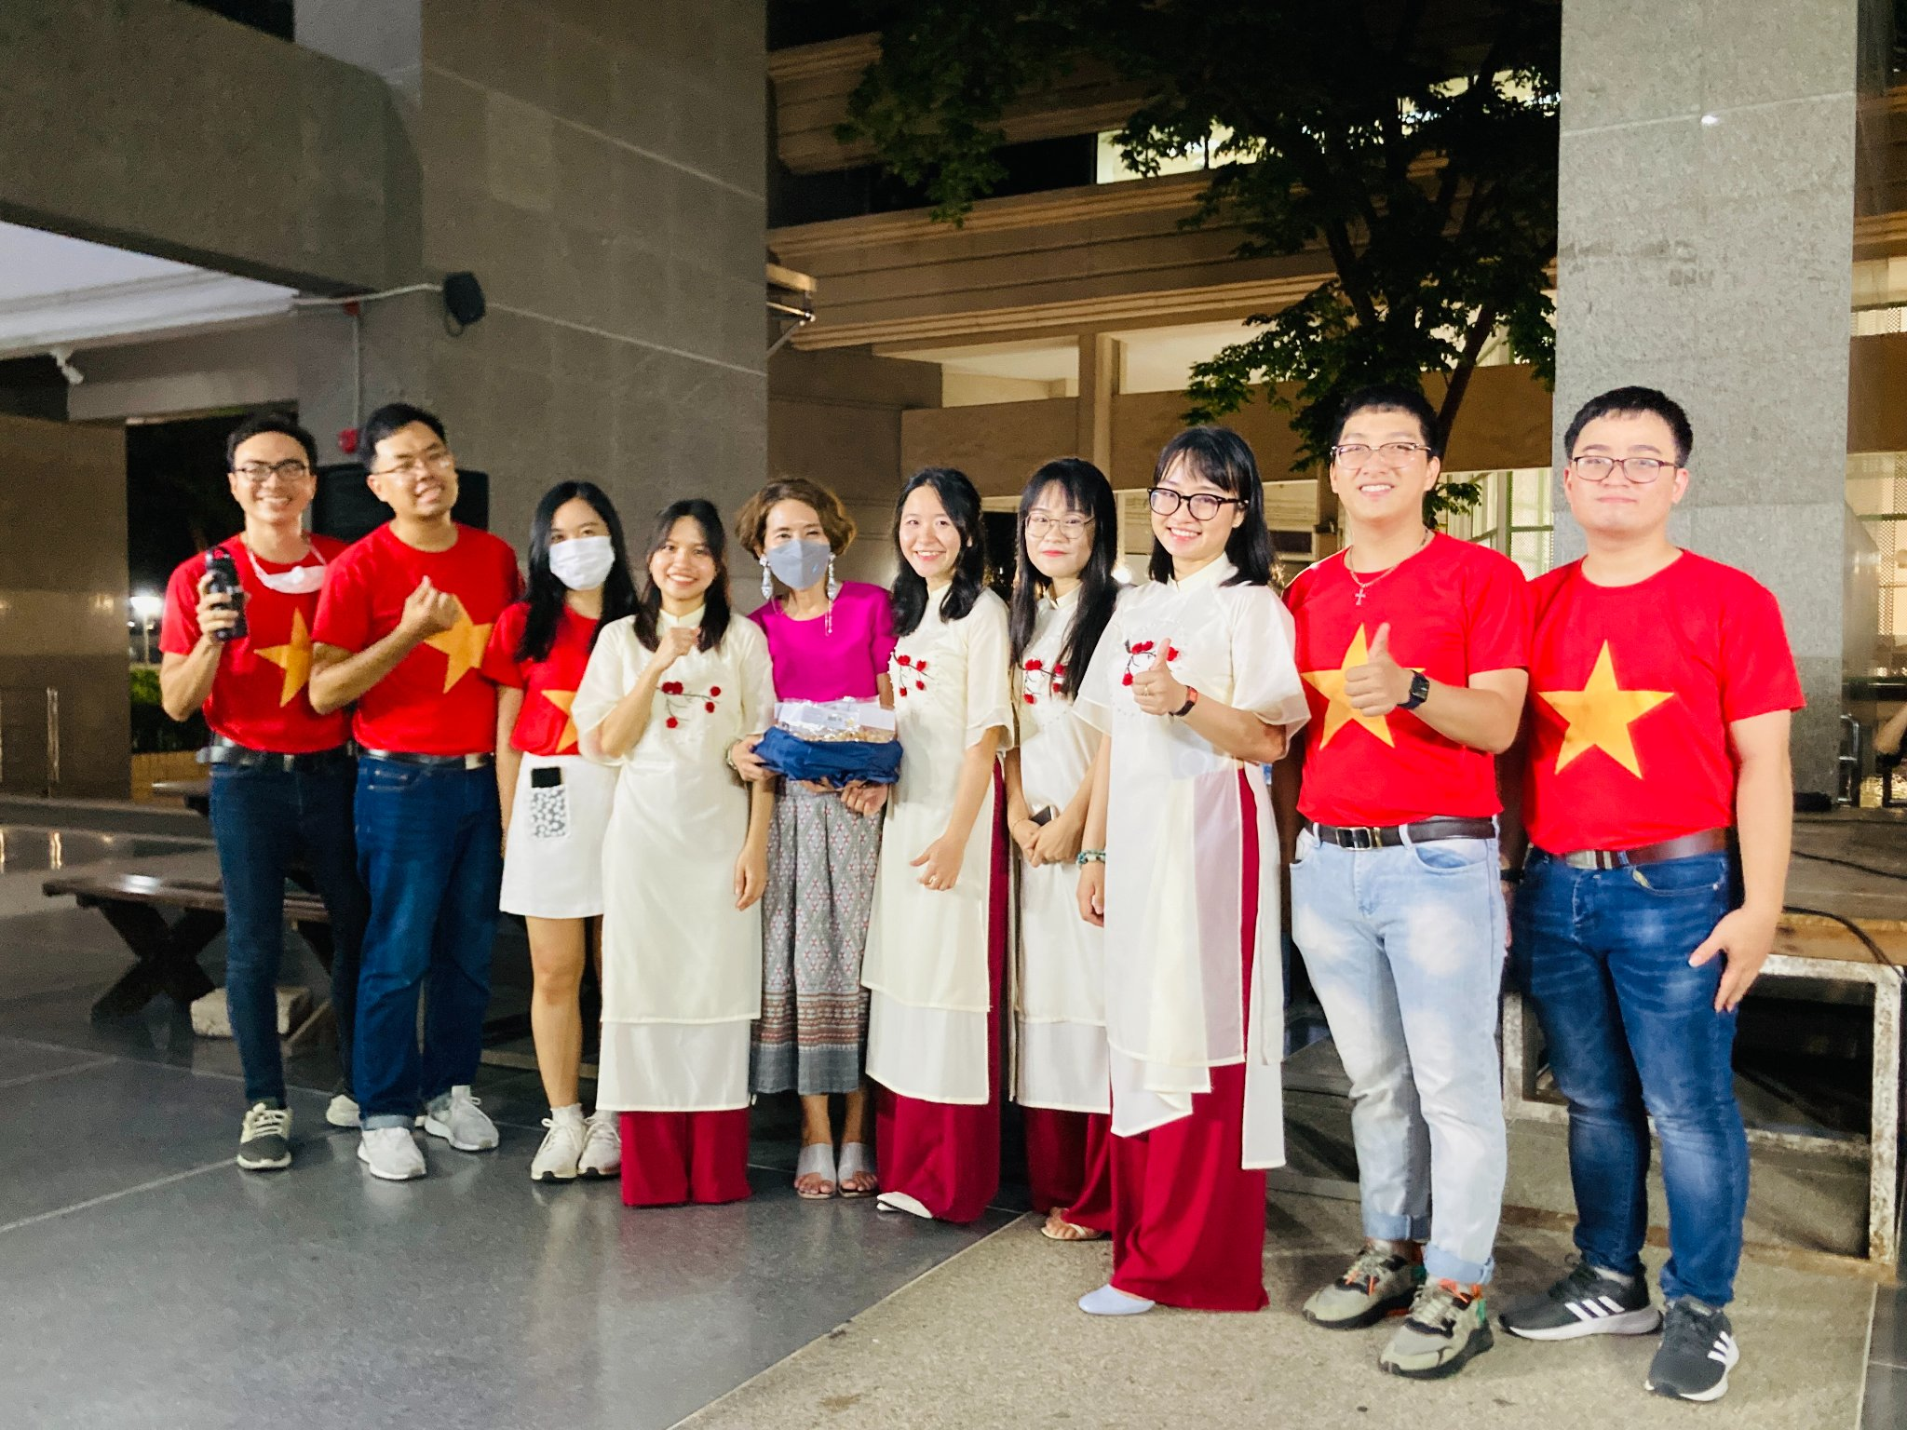
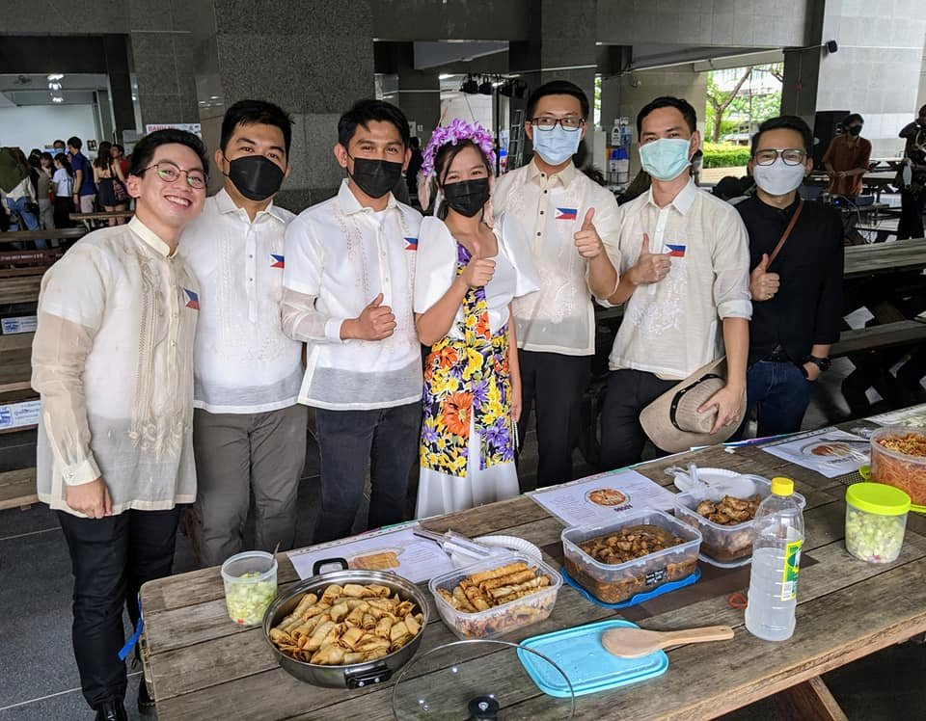
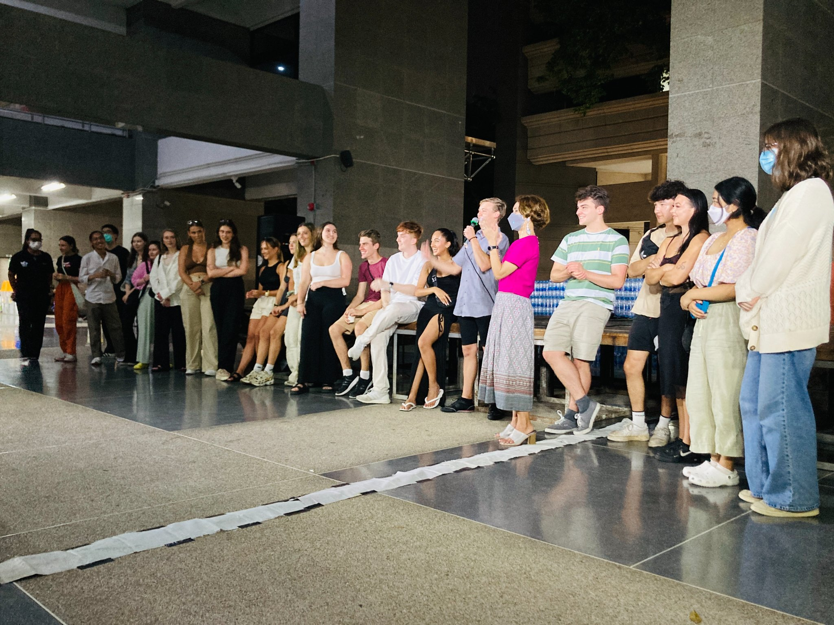
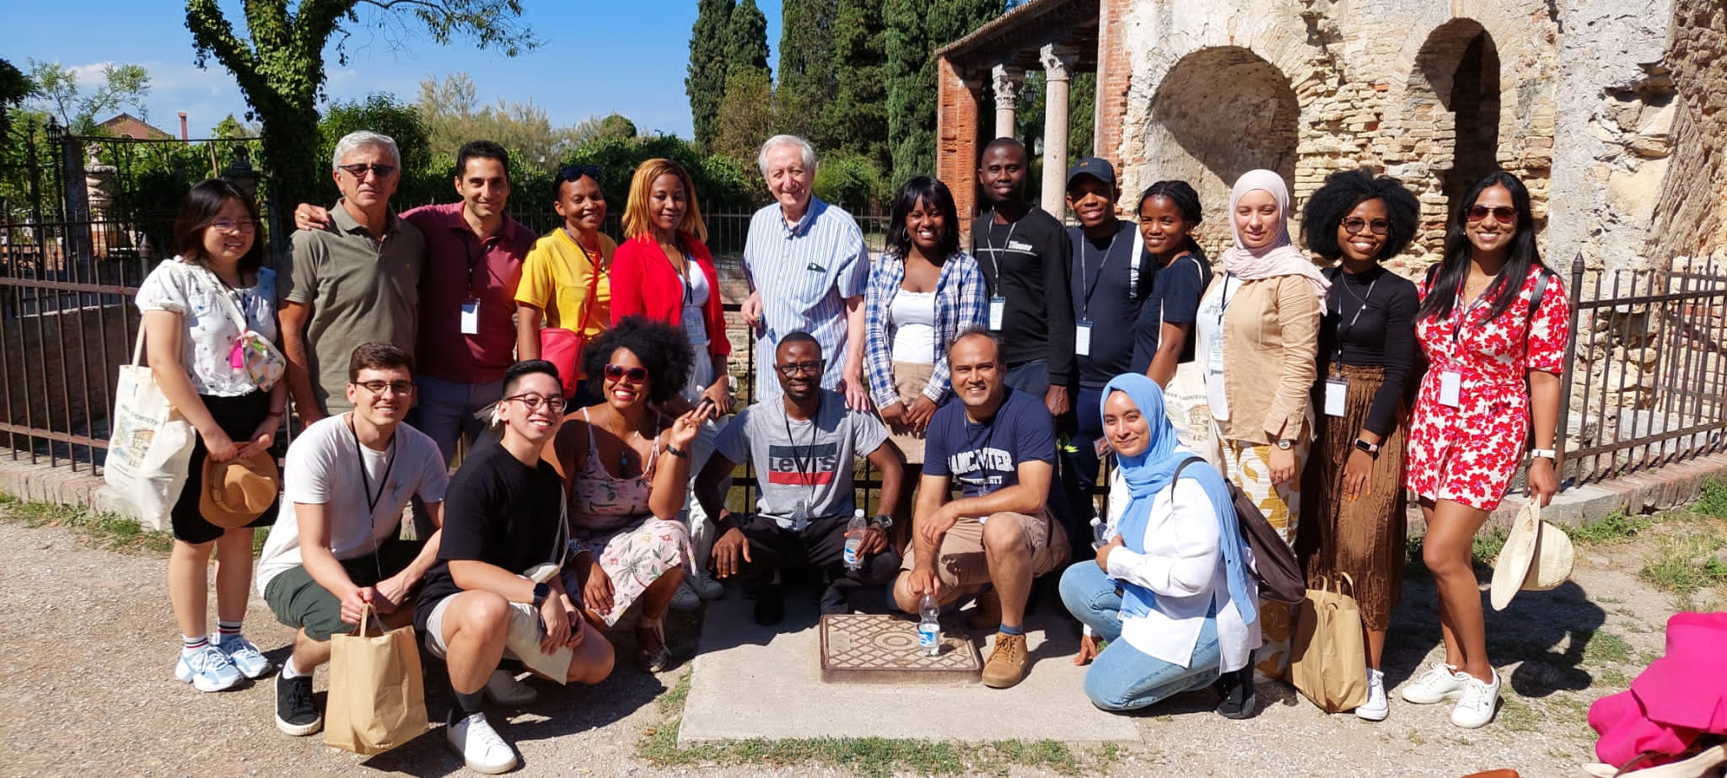
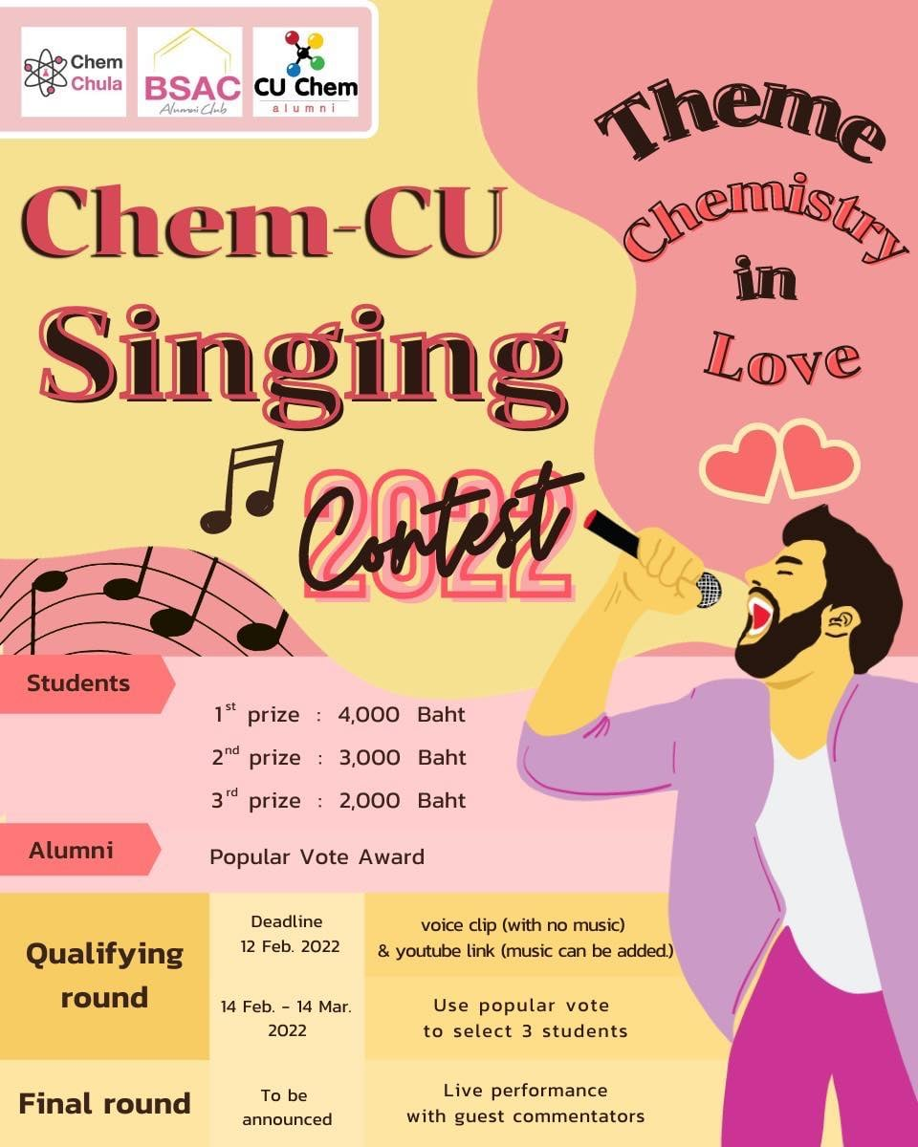
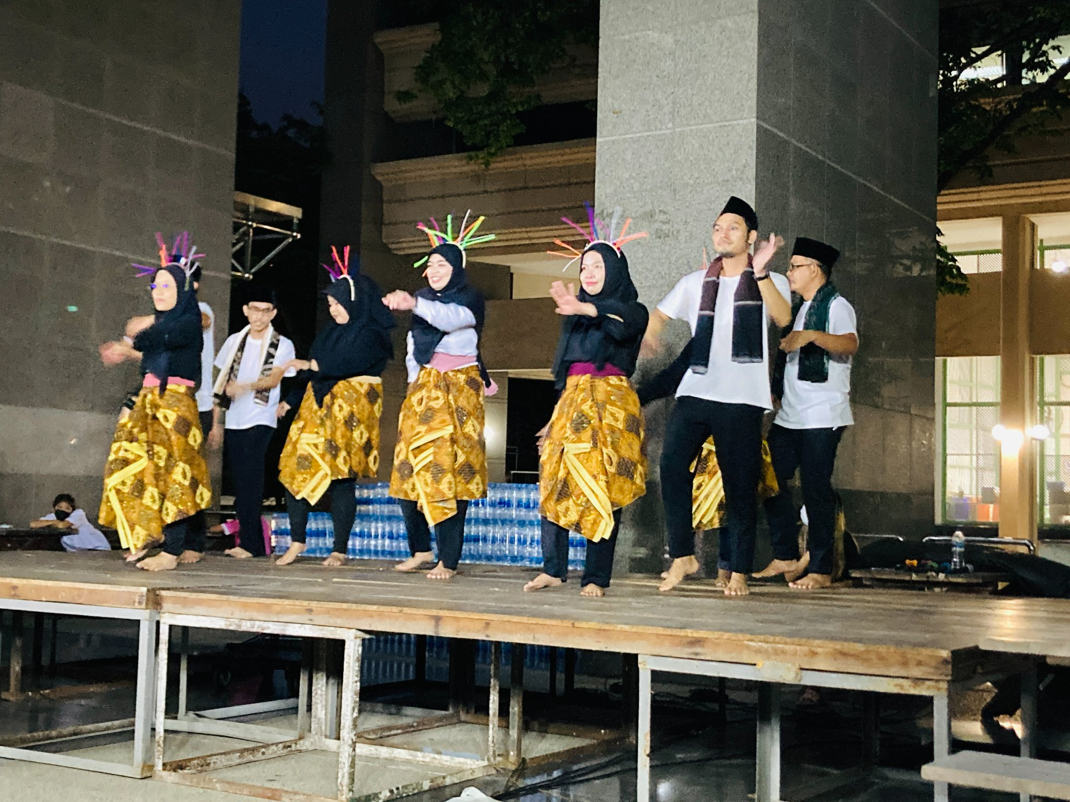
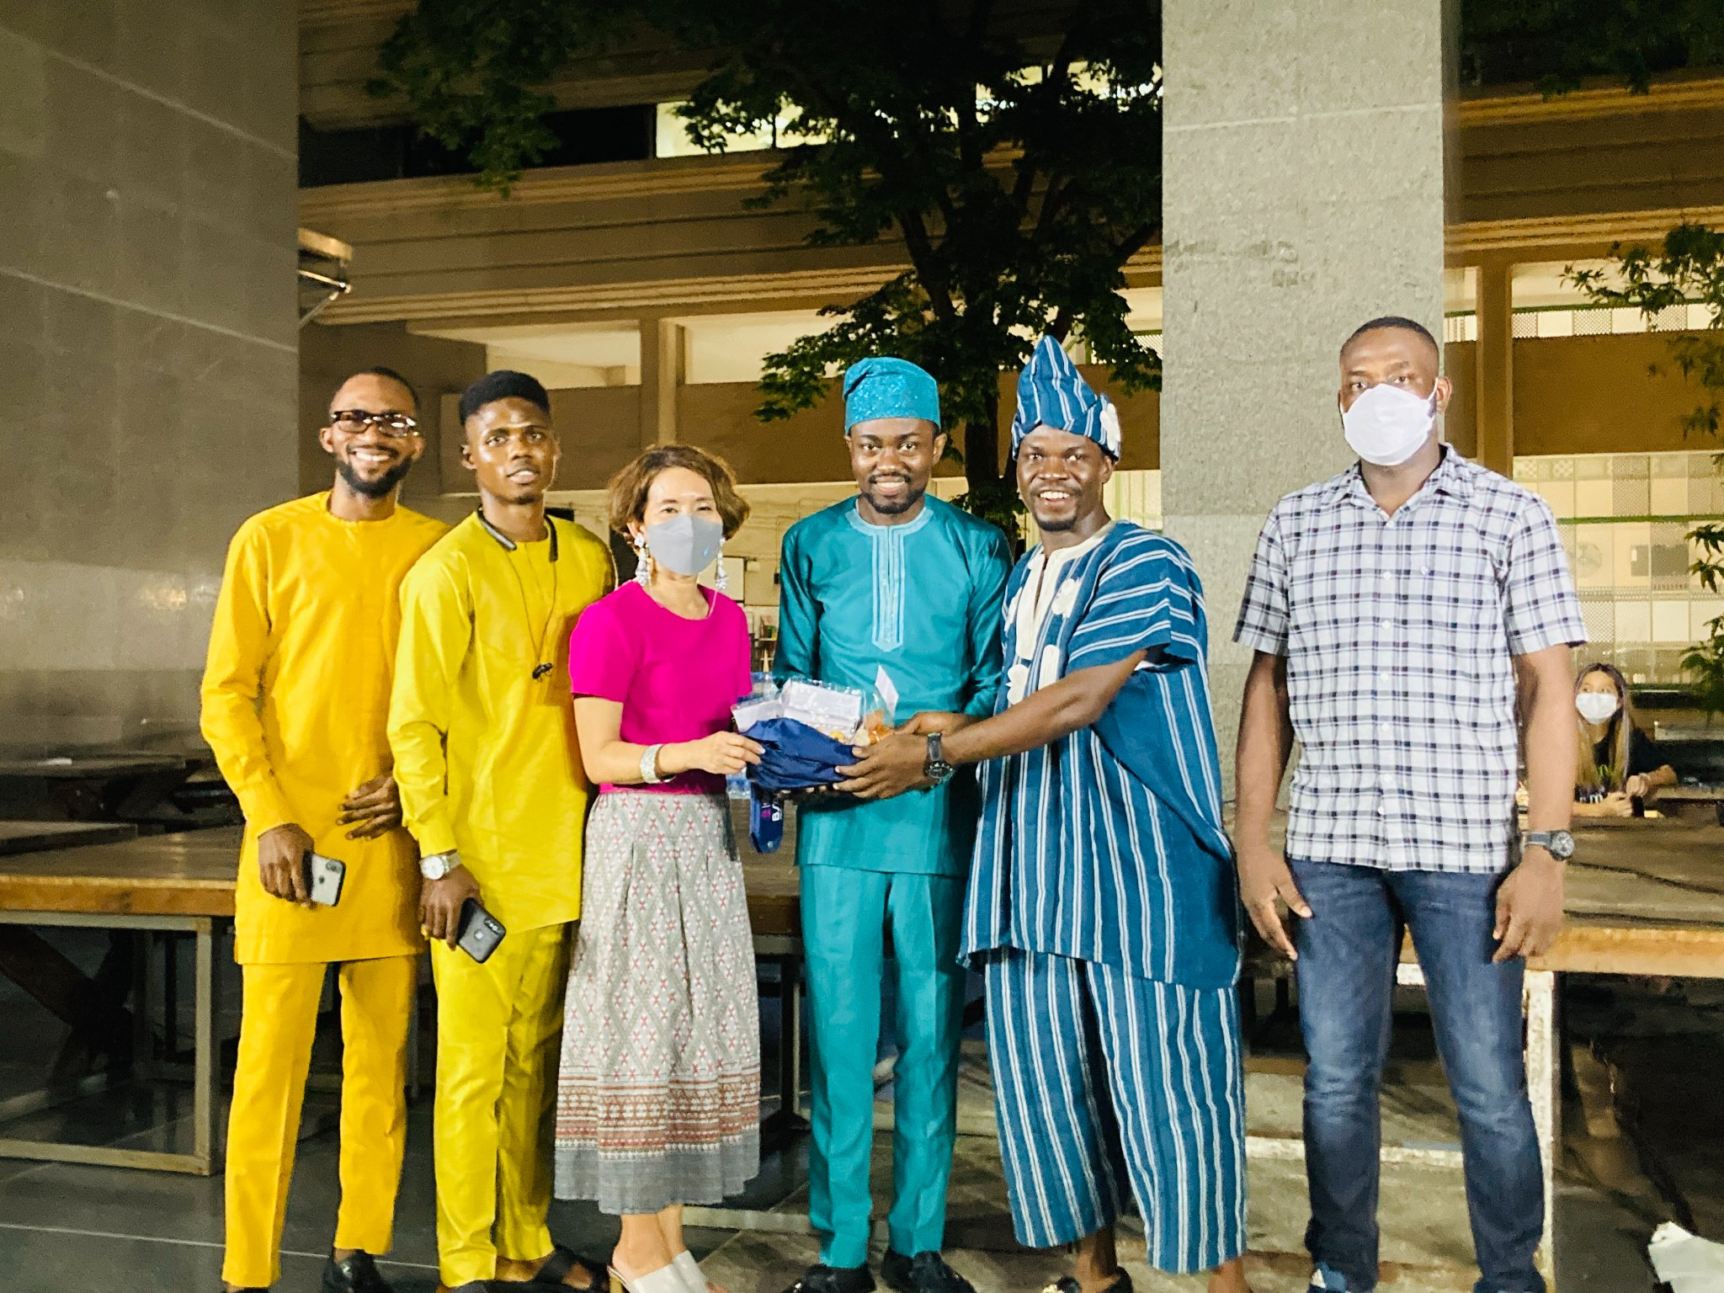
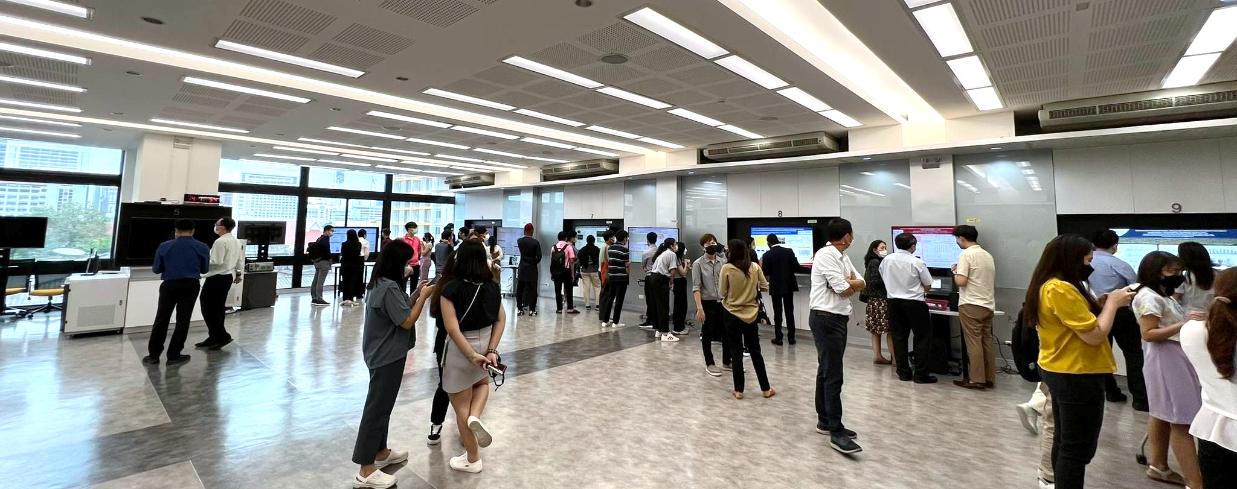
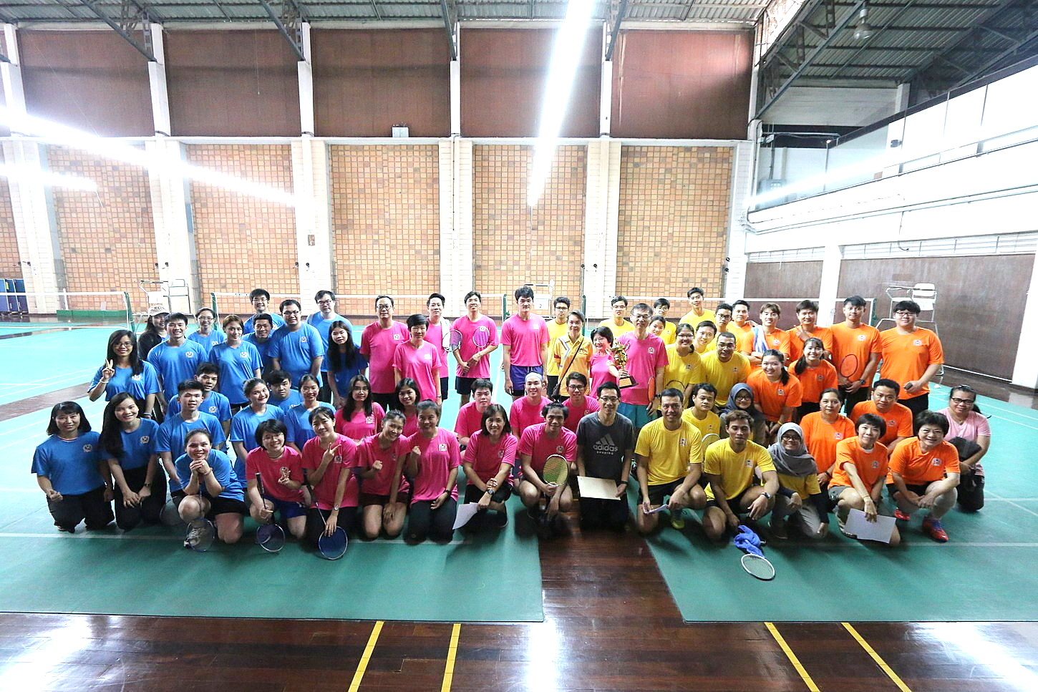
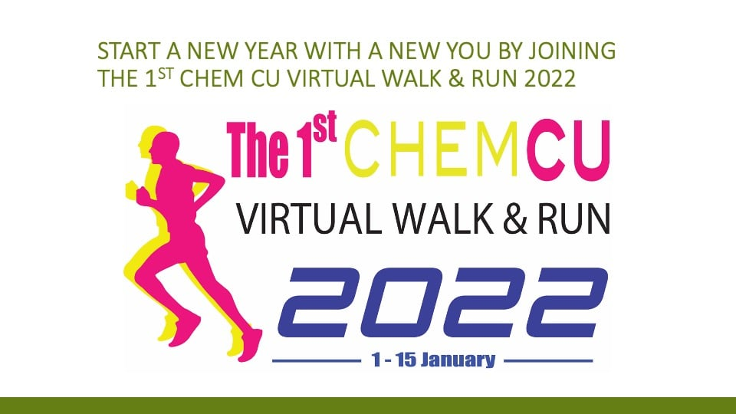
INTERNATIONAL STUDENT LIFE AND ACTIVITIES
Chem –CU International Night
International Symposiums
and Conferences
Chem-CU
Singing Contest
Sport
Activities

Slide 15
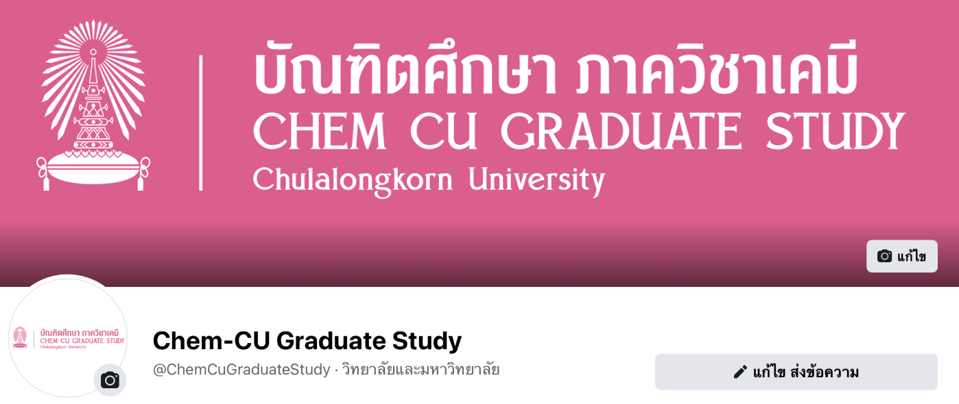

Industrial placement
APPLICATION TIMELINE for FIRST SEMESTER 2023
: 1st Round
Application period
1 Feb. - 15 Mar. 2023
Online Application
https://www.register.gradchula.com/
1
Chemistry
Thitirat.ph@chula.ac.th
Green Chemistry and Sustainability
suwat.m@chula.ac.th
2
Submission of relevent documents
3
Announcement of eligible candidates
22 Mar 2023
4
Interview
TBA via Email
5
Announcement of accepted candidates
7 April 2023

Slide 16



CONTACT
http://web.chemcu.org
Ms. Thitirat Phankham
Thitirat.ph@chula.ac.th
http://greensi.chemcu.org
Mr. Suwat Mueangta
suwat.m@chula.ac.th
ChemCUGraduateStudy
http://www.facebook.com/ChemCuGraduateStudy

